Slide 1
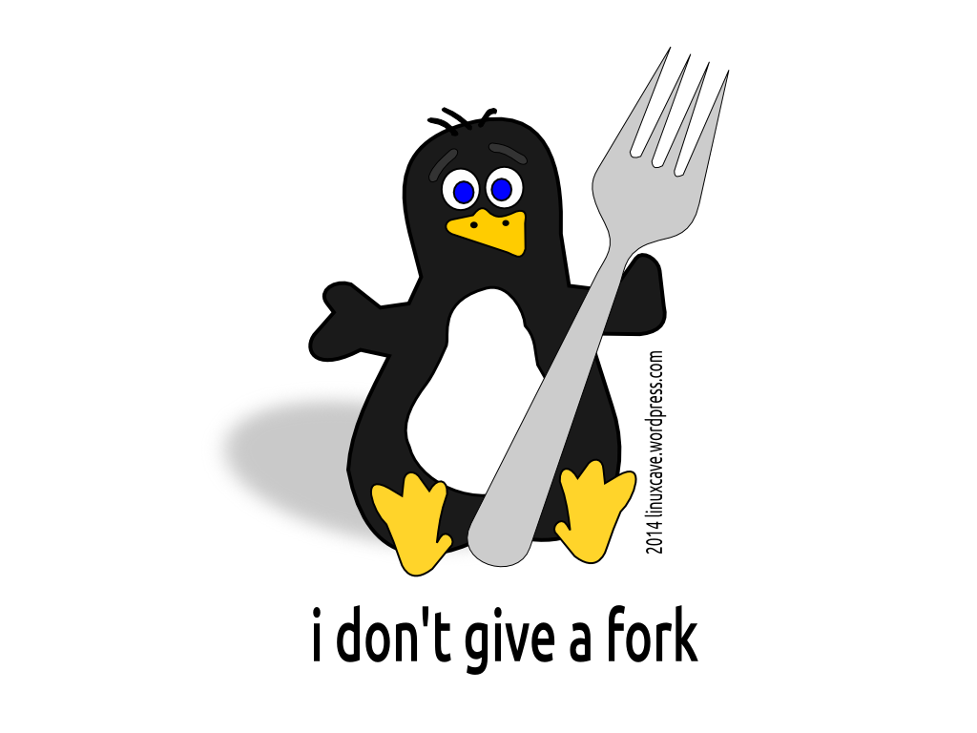
The programmer’s perspective on processes
1
The programmer’s perspective on processes

Slide 2

This lecture seeks to improve your understanding of processes. The concepts are important. You may eventually write C code and come back to that lecture, but it’s not our focus.
2
The programmer’s perspective on processes

Slide 3
Making processes
3
The programmer’s perspective on processes

Slide 4

Eventually Linux executes its first process: init. It has PID 1.
Before you start the computer, there is nothing...
And then more processes are created...
4
The programmer’s perspective on processes

Slide 5



To make a new process B, a process A duplicates itself. The copy has access to all of A’s material.
A
B
While they were created equal, they’re now mostly independent so they can start doing their own thing.
5
The programmer’s perspective on processes

Slide 6
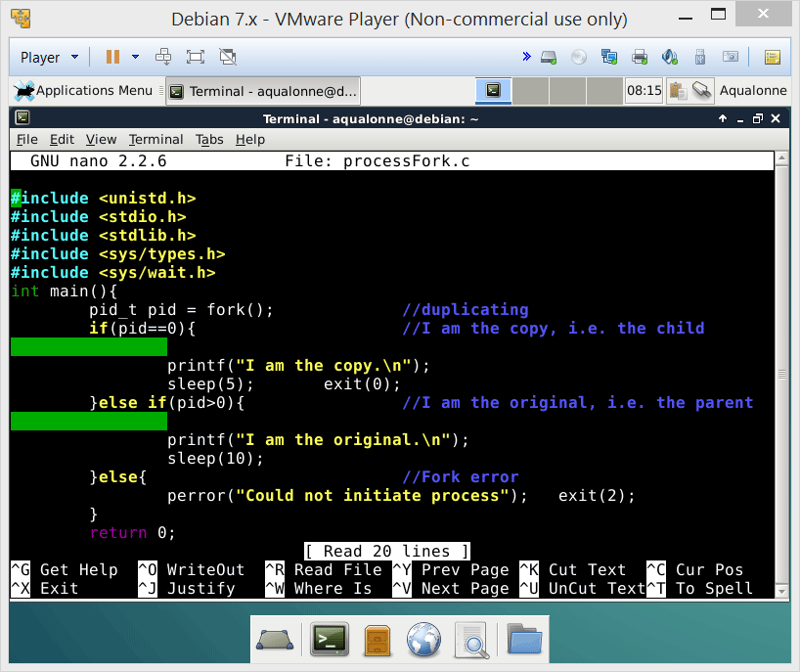
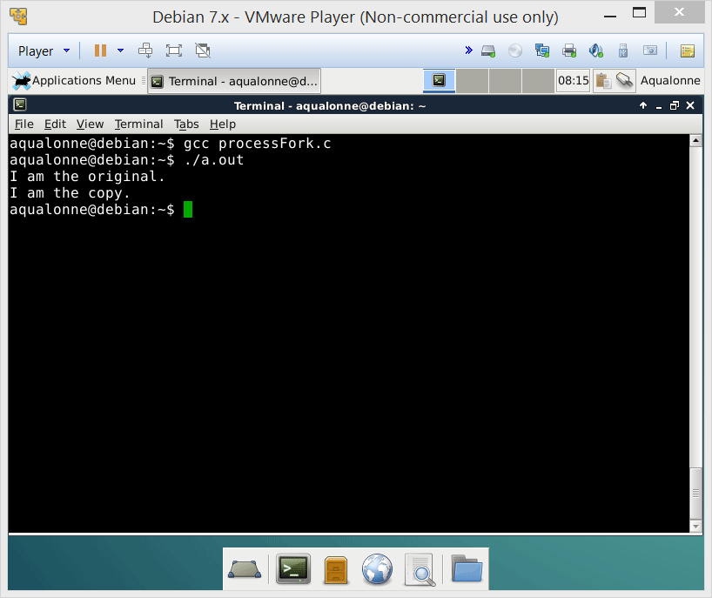
Making processes
The function fork() creates the copied process and returns two results:
0 for the forked process
>0 for the original
6
The programmer’s perspective on processes

Slide 7
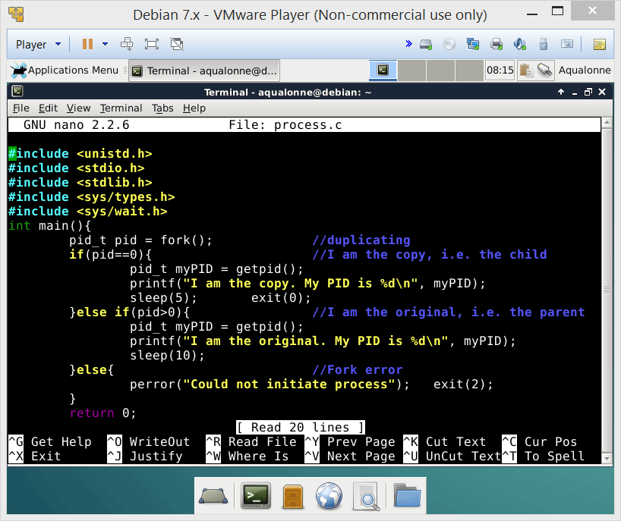
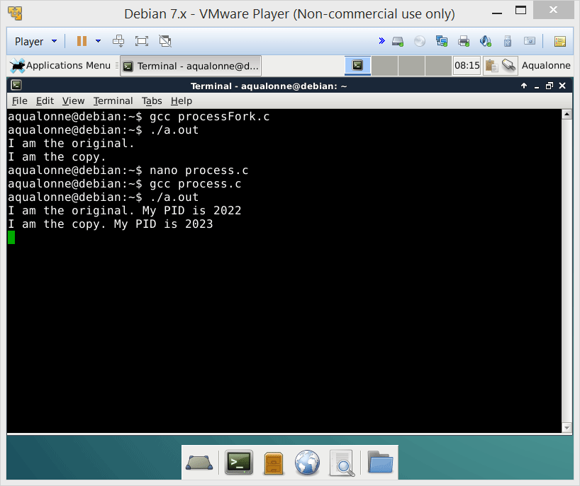
Making processes
You can check the ID of each process by getpid()
7
The programmer’s perspective on processes

Slide 8
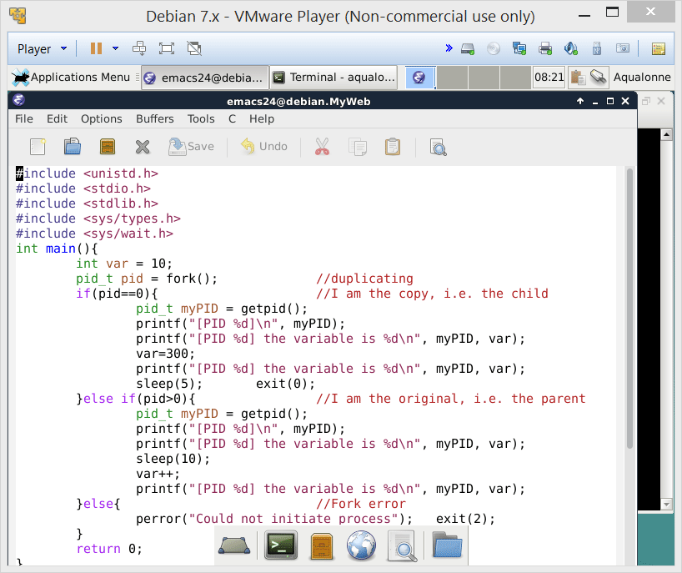
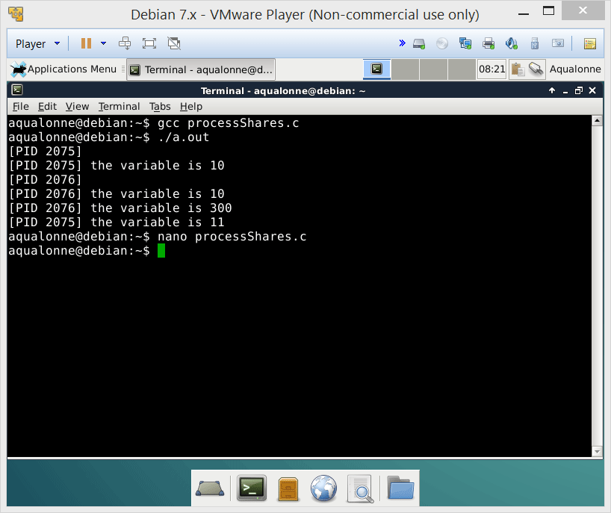
Making processes
The copied process also has a copy of the original process’ variables.
But the copied process is independent and has its own memory space.
10
10
i.e. the variables are independent too
8
The programmer’s perspective on processes

Slide 9
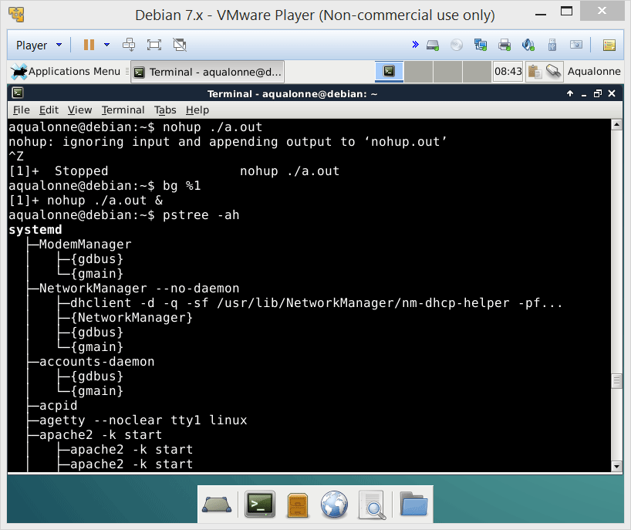
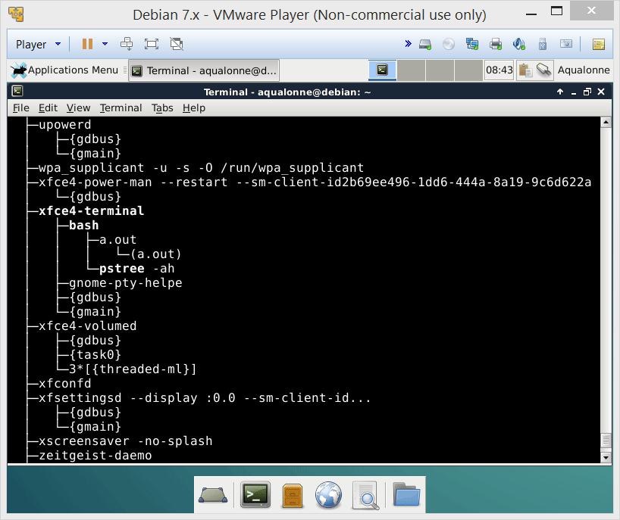
Making processes
When a process forks another one, you can see that relationship in pstree
The forked is given the same name as the original
But that name can be changed if you want...
9
The programmer’s perspective on processes

Slide 10

How processes interact
10
The programmer’s perspective on processes

Slide 11



How processes interact
Processes can interact by
waiting for time
sending
signals
waiting for a process to be done
These can be used to achieve tasks e.g. synchronizing
11
The programmer’s perspective on processes

Slide 12
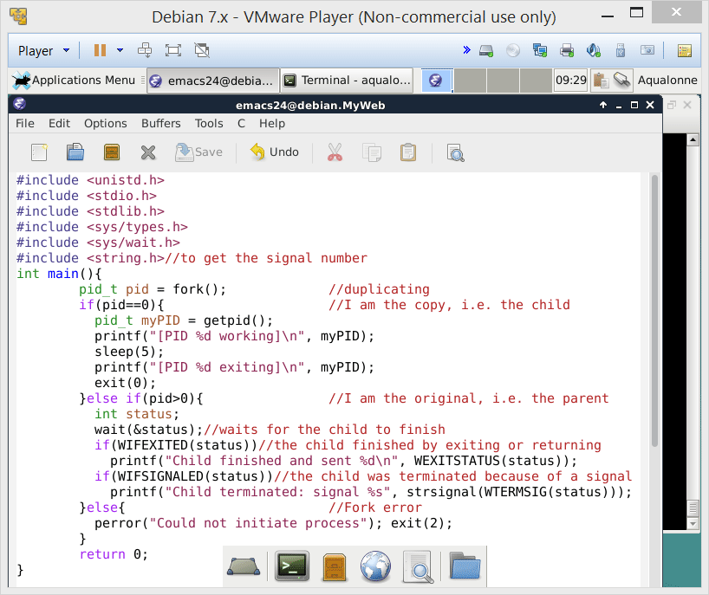
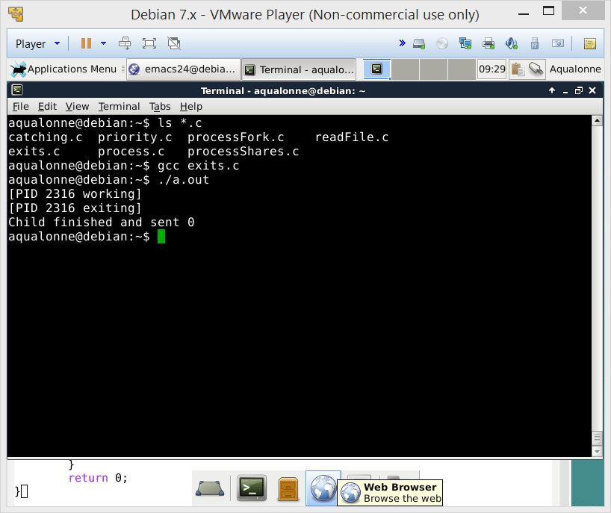
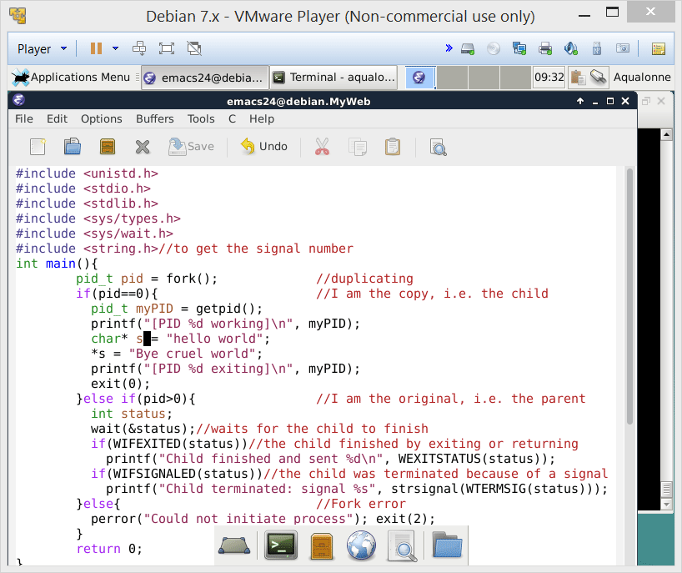
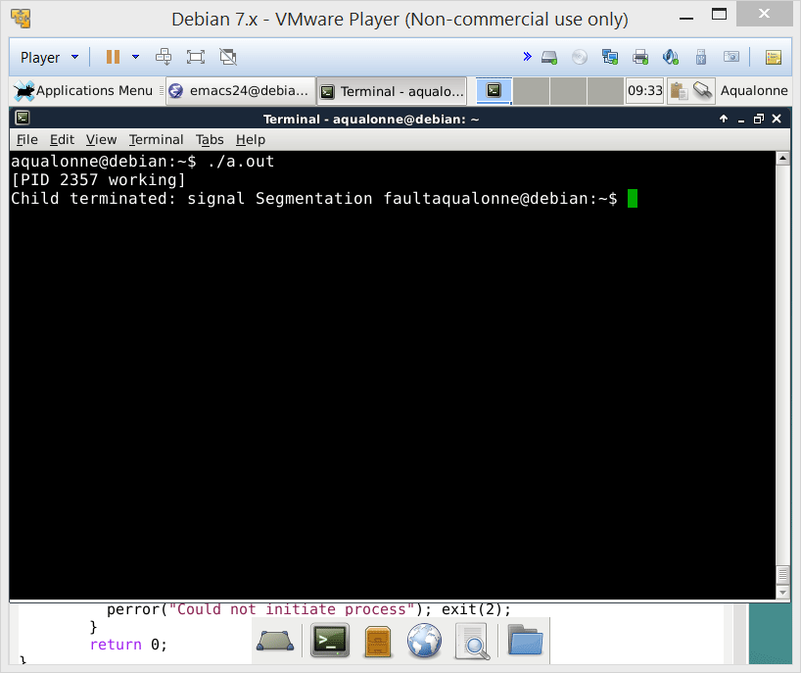
How processes interact
You can wait for a process to be done and ask whether it finished by exiting or got terminated by a signal.
12
The programmer’s perspective on processes

Slide 13





When processes are waiting on you, it’s important to exit as is expected
??
Not exiting properly can waste resources on either child processes or the parent
13
The programmer’s perspective on processes

Slide 14
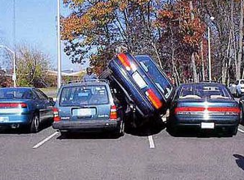
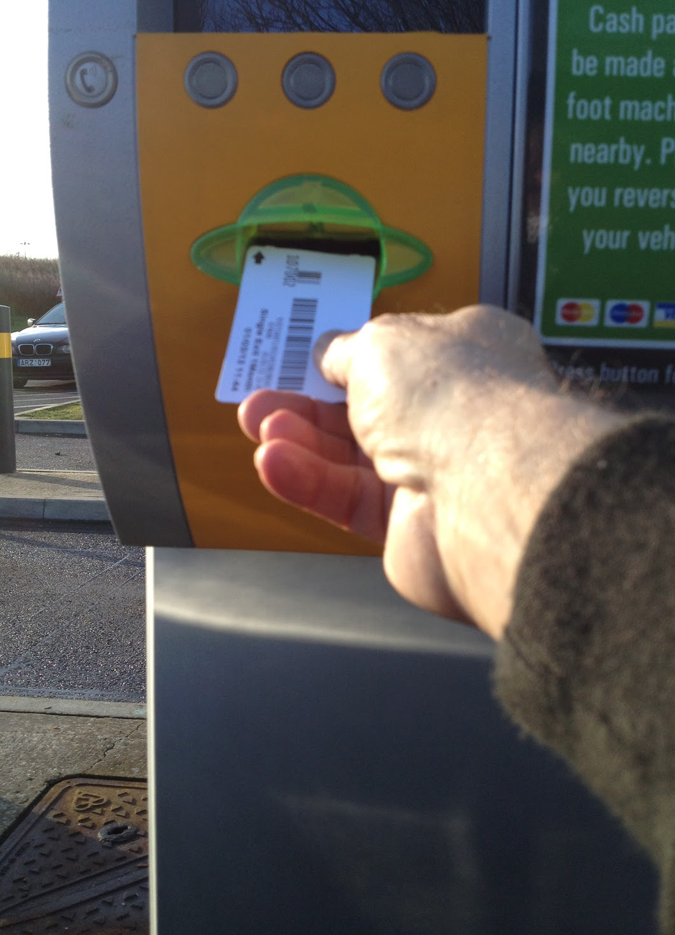

How processes interact
When you make a new process, it gets a PID and resources.
When the process is done, its father must acknowledge it. Between “I am done” and “Acknowledged”, the process is in a zombie state.
You do not want to pile up zombie processes!!!
14
The programmer’s perspective on processes

Slide 15

How processes interact
If the child exit before the father, then any time waiting for the father’s acknowledge is ‘zombie’
child
exit
father
fork
wait
exit
ZOMBIE
child
father
fork
wait
15
The programmer’s perspective on processes

Slide 16
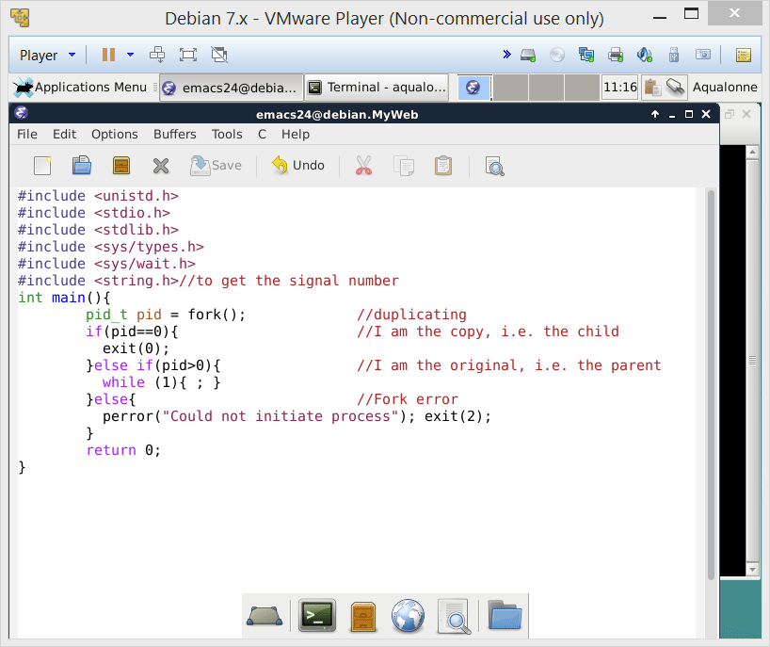
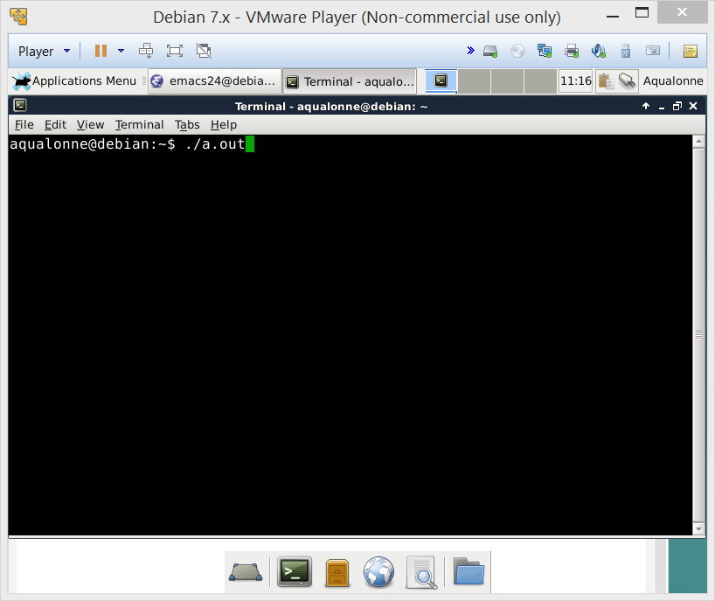

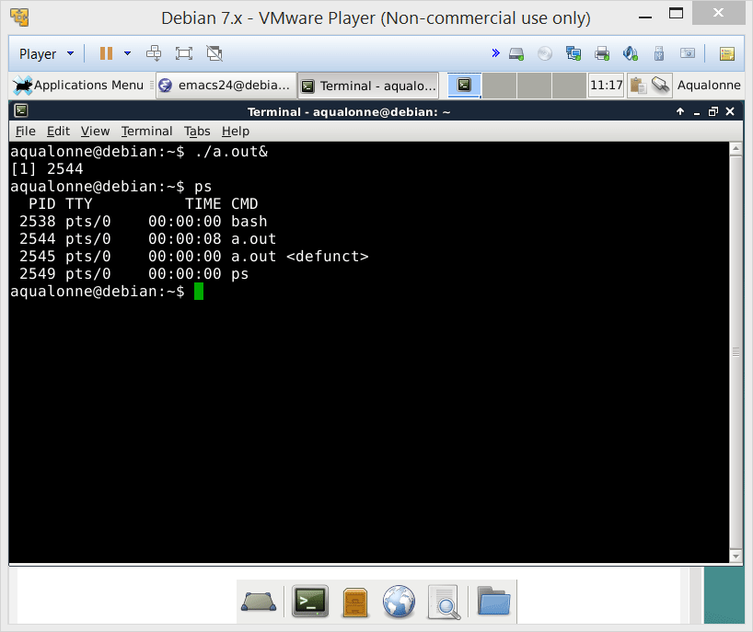
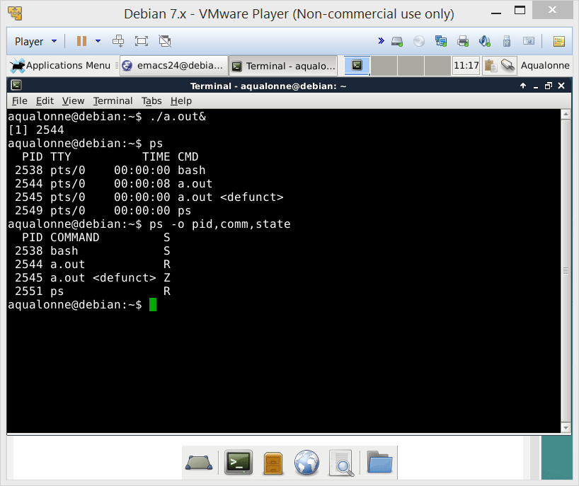
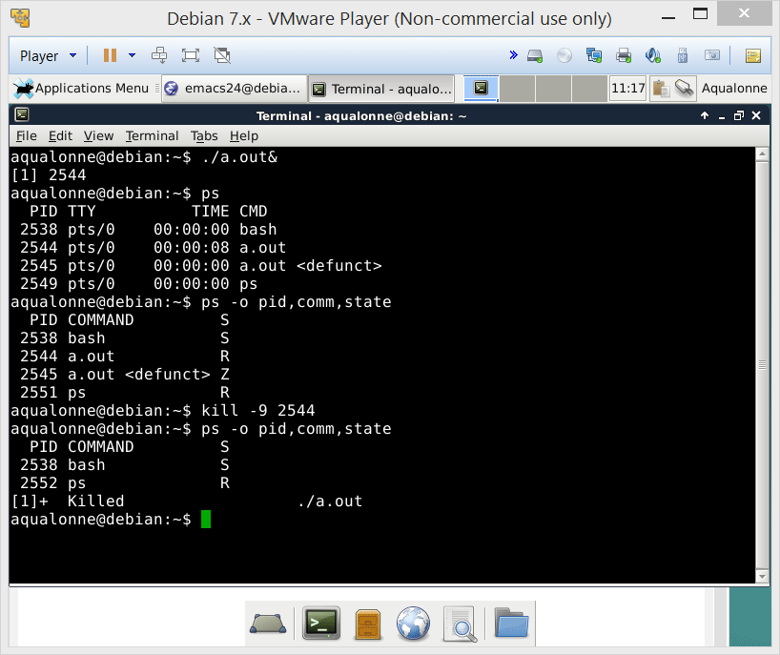
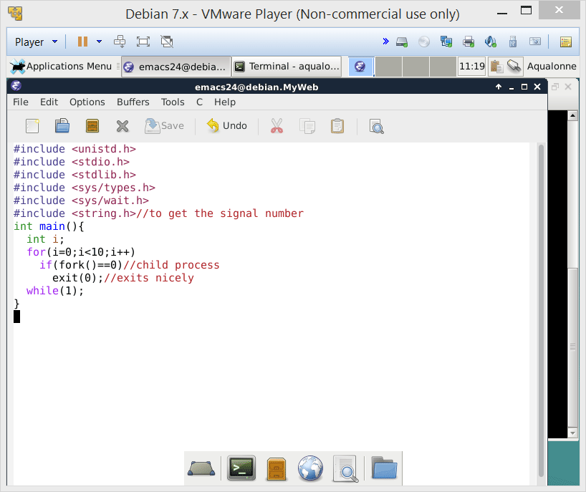
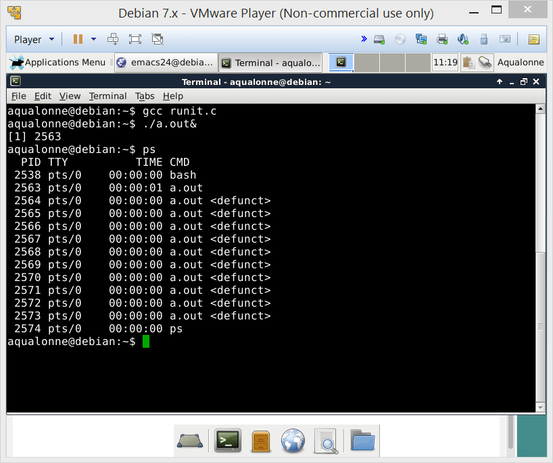
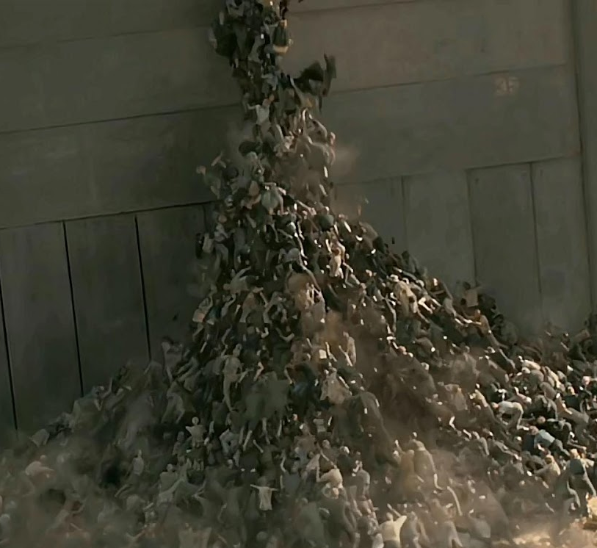

How processes interact
If you have zombie leak, these processes can stick around as long as the parent is running.
This can cause a zombie apocalypse with the system crashing too low on resources.
16
The programmer’s perspective on processes

Slide 17
How processes interact
If the child exit after the father, it becomes an orphan process
child
exit
father
fork
wait
orphan
child
father
fork
exit
init
Inherits orphan process
17
The programmer’s perspective on processes

Slide 18

How processes interact
Some processes become orphan on purpose: they do long running tasks in the background. These processes are called daemons, and their names normally end in d.
For example, crond is the daemon that runs scheduled jobs in the background.
If you want to know more about daemons, read Daemon (computing) on Wikipedia
18
The programmer’s perspective on processes

Slide 19

What are processes used for
19
The programmer’s perspective on processes

Slide 20


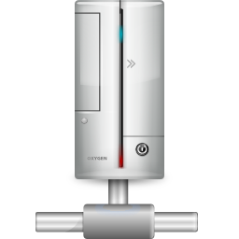
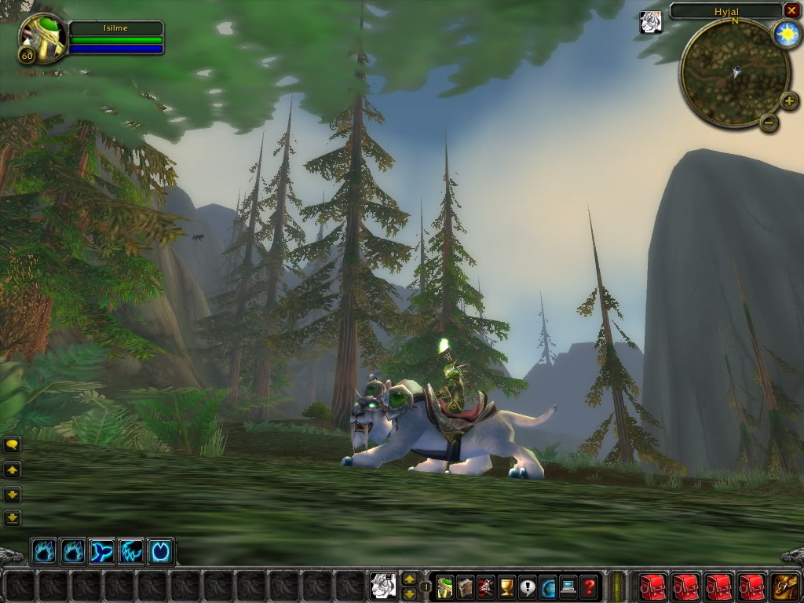
What are processes used for
Imagine that you made an online game. The first player connects to the game...
If there is no concurrency, then it means you can only serve one player.
So your online game is basically a one player game...
20
The programmer’s perspective on processes

Slide 21
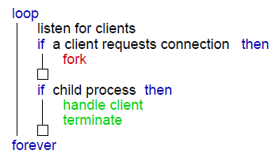
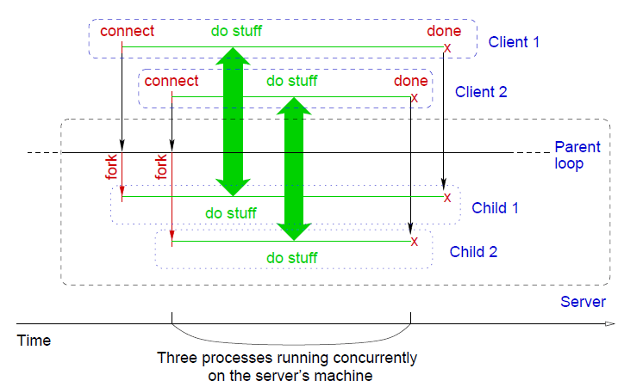
What are processes used for
One way to program a server is to fork.
(diagrams from Dr Bruda)
21
The programmer’s perspective on processes

Slide 22
for (int i = 0; i < max_processes; i++) { // we create the processes.
int pid = fork();
if (pid < 0)
perror("fork");
else if (pid == 0) { // child, manages the client-server communication
while (1) {
// Accept connection:
ssock = accept(msock, (struct sockaddr*)&client_addr, &client_addr_len);
if (ssock < 0) {
perror("accept");
continue; // we do not return, next time we may be luckier!
}
// accept successful
printf("Incoming client.\n");
do_client(ssock);
close(ssock);
printf("Outgoing client removed.\n");
}
return 0; // will never reach this point...
} // end of child code
else // parent
close(ssock); // parent has no use for ssock, and it goes again
// to create the next child.
}
return 0; // processes created, we are done.
}
A server may have one loop to create processes...
Each child process waits for a client to connect...
Serves it and ends
(code from Dr Bruda)
22
The programmer’s perspective on processes

Slide 23
What are processes used for
This design first creates all the processes, and then has them regularly check if someone wants to talk to them and initiate a connection. How else could you have designed this?
Take a few minutes to discuss it with the person next to you ☺
Knock knock!
Enter!
Let’s make a process
The alternative is to make a process when somebody connects. What do you think differs?
23
The programmer’s perspective on processes

Slide 24

What are processes used for
Making a process is not free or instantaneous!
By creating all processes when the server starts, we put all the load at once. Then, when clients connect, we don’t spend time making processes.
We pre-allocate processes
FYI there are also risks. Memory leaks with that design can cause really ugly problems.
24
The programmer’s perspective on processes

Slide 25

You’ve had a peek at how a system manages concurrency by forking processes.
There is another way named threads. They can both do concurrency but they have significant differences so a programmer needs to think of which one is best for the task.
25
The programmer’s perspective on processes

Slide 26

Beyond forking
26
The programmer’s perspective on processes

Slide 27
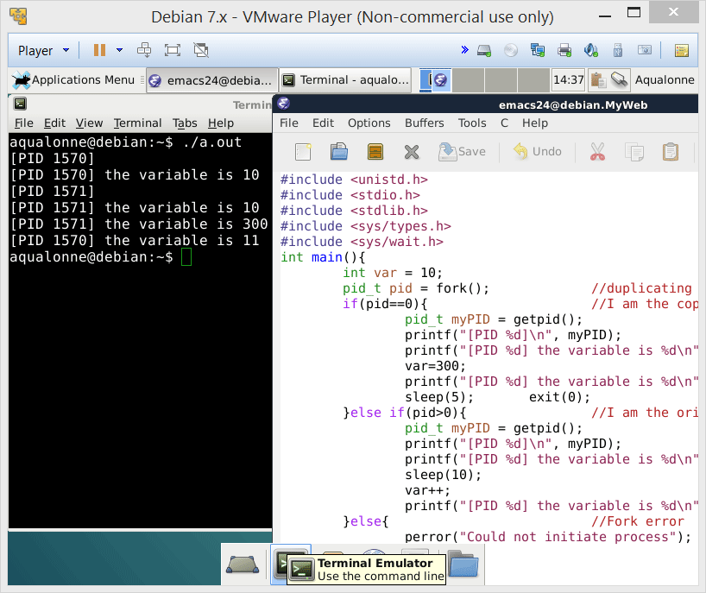
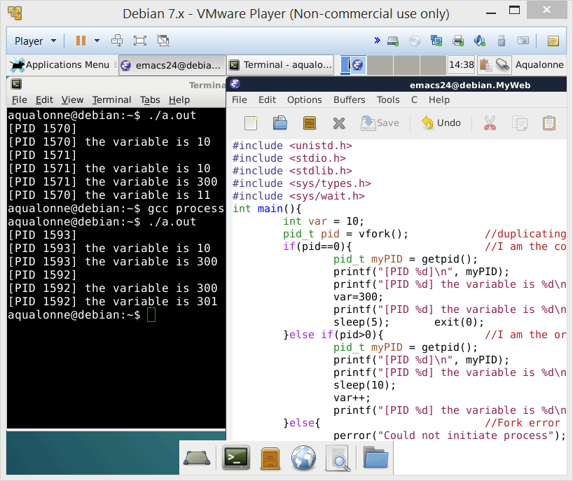
Beyond forking
So far we only used fork. The child has its own memory space, and values are initially the same as the father’s
With vfork, one difference: the child does not get its own address space.
Why do you think we’d use vfork instead of fork?
27
The programmer’s perspective on processes

Slide 28

Beyond forking
vfork is used if the child process does not care about the parents’ variables at all
For example, it could load and run a totally different program.
When you get into systems programming, resources such as memory are managed pretty tightly. So there are ways to optimize the slightest operation...
28
The programmer’s perspective on processes

